Slide 1
FHWA 2023 Work Zone Safety Grant
Notes:
Also perform introductions prior to beginning the presentation

Slide 2
FHWA 2023 Work Zone Safety Grant
$2.5M granted to ATSSA over 5 years
  February 2024 to February 2029
Area 1 - Training
  Offering grant courses both in-person and virtually
  Developing waitlist of interested organizations
Area 2 – Guideline Development
  Guideline Updates
  Practitioner Work Group Meetings
  Regional Product Demonstrations
Area 3 – Guideline Training
  Update and Develop Training Materials

Slide 3



Products and Topics by Grant Area
Area 1
Training targeted to craft workers and field personnel
Existing Courses:
  Traffic Control Technician
  Traffic Control Supervisor
  Flagger Instructor
  Maintenance and Short Duration Activities
Area 2
Update Existing Publications
Publication development
Product Demonstrations
Area 3
Training on the Area 2 publications
Deliver training to practitioners

Slide 4
ATSSA 2023 Courses Overview
Area 1:
  10 Traffic Control Technician Courses (TCT) per year
  10 Traffic Control Supervisor Courses (TCS) per year
  5 Flagger Instructor Training Courses (FIT) per year
  5 Maintenance and Short Duration Activities (MSDA) per year
Area 3:
  5 courses total per year of the 11 different courses

Slide 5
Area 3 Training Course Offerings
Designing Temporary Traffic Control Zones for Pedestrian Accessibility
Developing and Implementing Successful Transportation Management Plans
Minimizing Worker Exposure in Highway Work Zones Through the Use of Positive Protection and Other Strategies
Smarter Work Zone Intelligent Transportation Systems
Traffic Control Design Specialist
Urban Work Zone Design
Work Zone Road Safety Audits
Work Zone Strategies

Slide 6
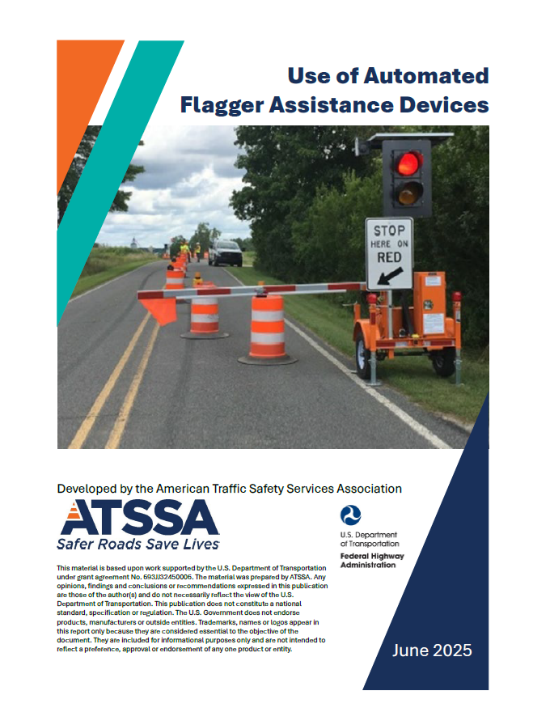
AFAD Publication
Updated in 2025 from a previous version
Types of devices and features
Requirements for use
Safe practices
Use of Automated Flagger Assistance Devices — Work Zone Safety Information Clearinghouse

Slide 7
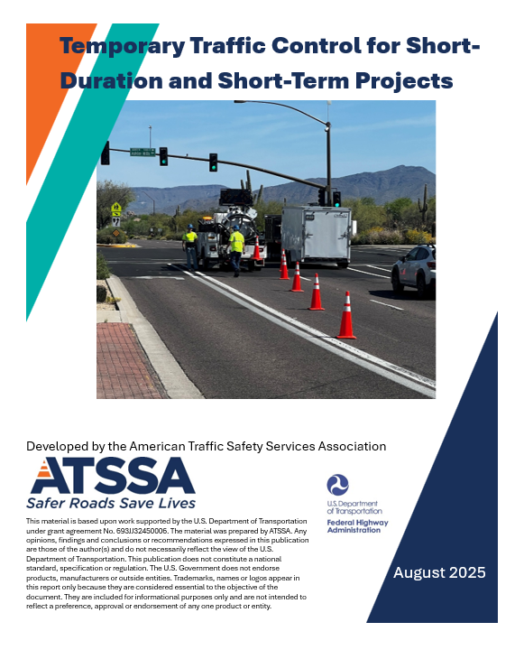
TTC for Short-Term and Short-Duration
Updated in 2025 from a previous version
Originally a “Maintenance Pocket Guide”
Covers MUTCD guidance on shorter project durations
Provides checklist examples for two-lane, multi-lane, and intersections
Includes very short duration example
Temporary Traffic Control for Short-Duration, Short-Term Stationary, and Mobile Operations — Work Zone Safety Information Clearinghouse

Slide 8
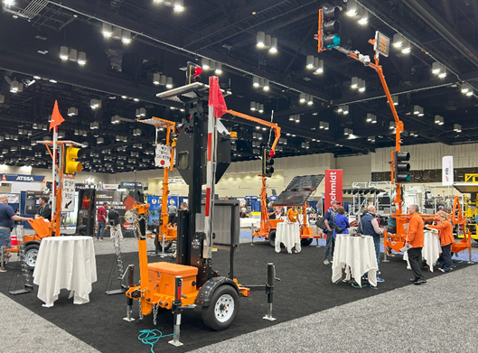
2025 - AFAD/PTS/RDTS Demo
Included:
  1 RDTS
  2 PTS
  2 AFADs
Highlighted features and applications
Up next: Nighttime operations

Slide 9
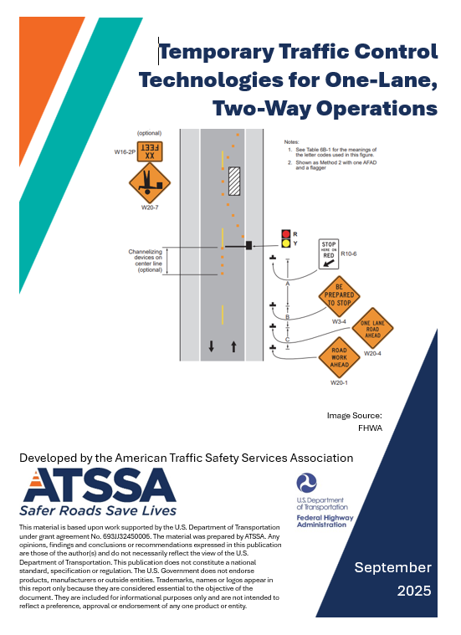
AFAD/PTS/RDTS Case Studies
Examples of use for:
  Trailer-mounted PTS
  Cart/pedestal-mounted PTS
  AFAD
  RDTS
Case study examples from South Dakota, North Carolina, and Michigan
Temporary Traffic Control Technologies for One-Lane, Two-Way Operations — Work Zone Safety Information Clearinghouse

Slide 10
Notes:
Also perform introductions prior to beginning the presentation

